Slide 1
Decision tree
Supervised learning
분류 트리분석
회기 트리분석
ID3, C4.5, C5.0
Classification And Regression Tree, CART
 | 알고리즘 | splitting
인공지능,기계학습 | ID3, C4.5, C5.0 | Entropy, inf gain
통계학 | CART | gini

Slide 2

학습법
입력 변수
목표 변수
predict
x1:성별, x2:나이, x3:가족 ….
Y: 사망여부

Slide 3
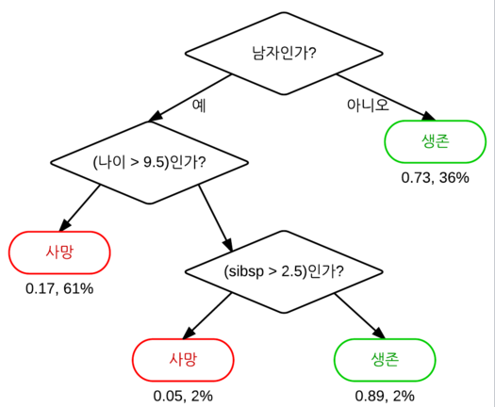
graph
Root node
internal node
leaf node, terminal node
Class label

Slide 4
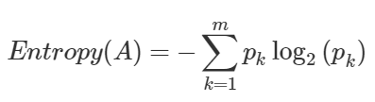
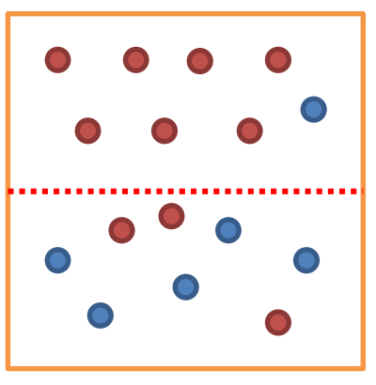

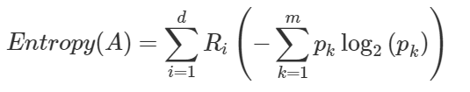
Entropy
A
before
Pk: 범주안에 속한 비율
after
Pk,Ri: 범주안에 속한 비율
Ep: 0 -> pure
Ep: 1 -> impure
Information gain:
Before entropy(A) – After entropy(A)
(choose attribute that results in greatest information gain)
Splitting line

Slide 5
Gini
Split before
Gini(T) = $\sum_{k=1}^{n}{{p_{k} \text{(1-} p_{k} \text{)}}^{}}$ =1 -$\sum_{k=1}^{n}{{p_{k}}^{2}}$
Split after
${Gini}_{split}\left(T\right)= \frac{N_{1}}{N}Gini\left(T_{1}\right)+$ $\frac{N_{2}}{N}Gini\left(T_{2}\right)$
smallest ${Gini}_{split}\left(T\right)$ is chosen to split the node

Slide 6
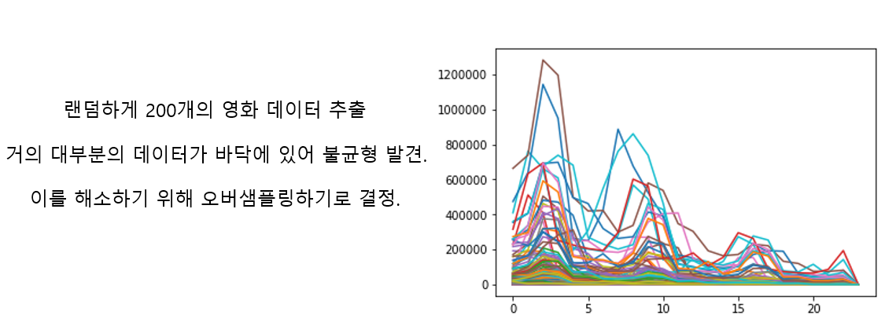
Bootstrap aggregating(bagging)
Avoid overfitting

Slide 7
Ensemble learning methods
Random forest
Boost tree
회전 포레스트

Slide 8
Random forest
임의 노드 최적화(randomized node optimization, RNO)와 배깅(bootstrap aggregating, bagging)을 결합한 방법과 같은 CART(classification and regression tree)를 사용
Robust to noise

Slide 9
Most often used algorithm
ID3 -> C4.5 -> C5.0

